Slide 1






Abrupt cooling over the North Atlantic in modern climate models
Sgubin G., Swingedouw D., Drijfhout S., Mary Y. and Bennabi A.
Blue Action kick-off meeting, the 19th of January 2017

Slide 2
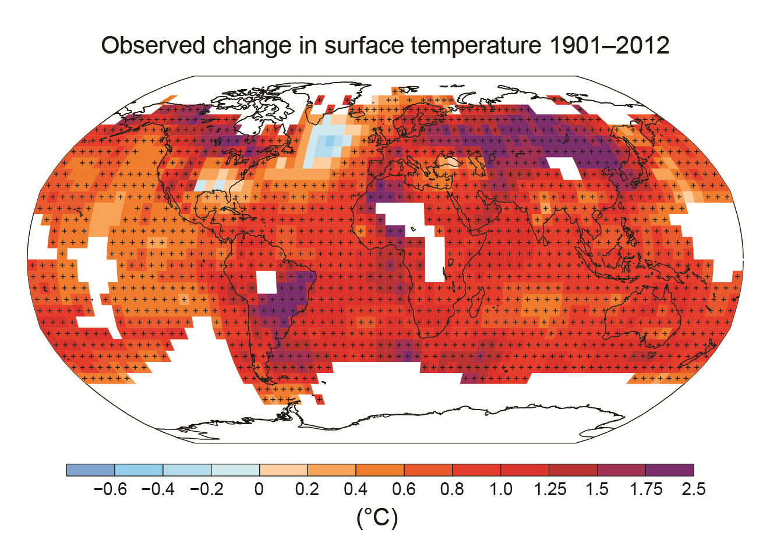
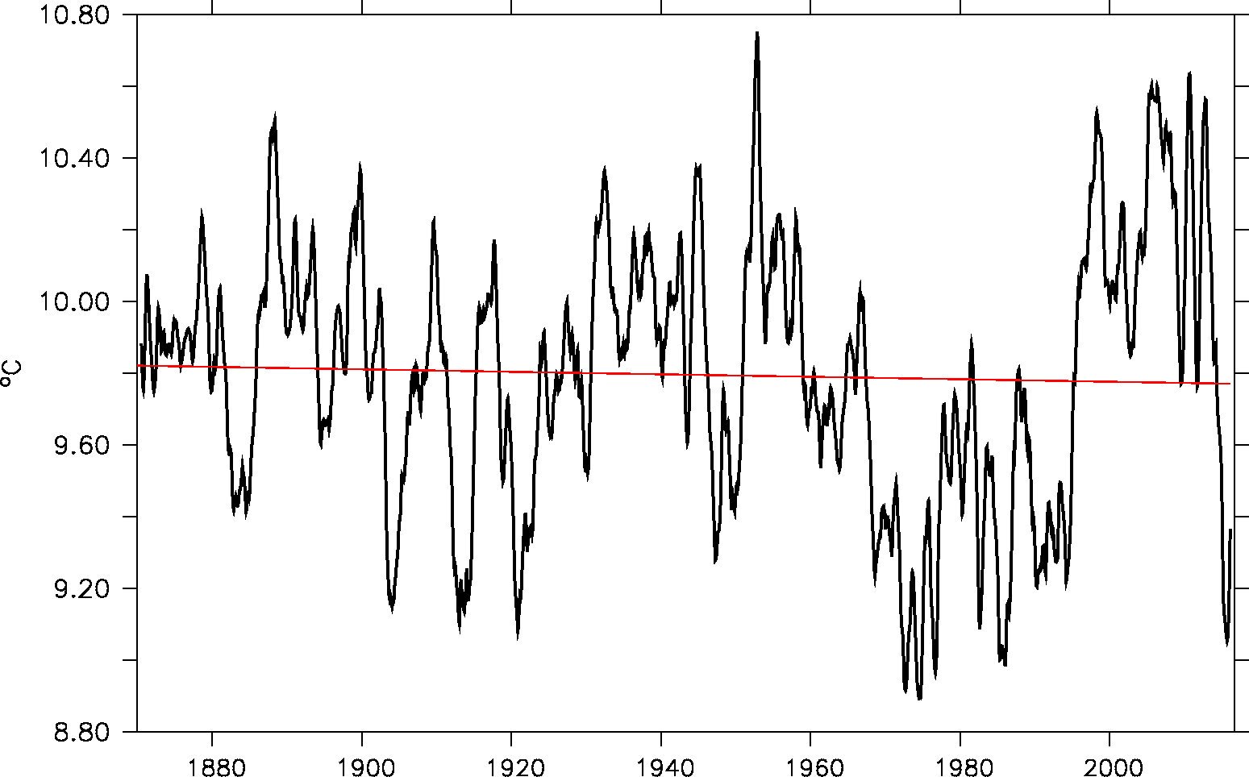
A cold blob in the North Atlantic?
Warming hole in the North Atlantic over the 20th century
Abrupt SST variations in the subpolar gyre (Thompson et al. 2010)
Robson et al. (2016): link with anomalous surface heat flux and Labrador Sea convection
Trend (1901-2012) in surface temperature from HadCRUT4
IPCC. 2013
SST in SPG (50º-20ºW; 45º-62ºN)
Year Data used: HadISST

Slide 3
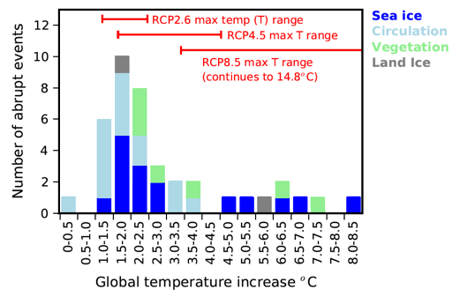
Are the model showing abrupt changes in the subpolar gyre trustworthy?
39 abrupt events (in 36% of the realizations)

Slide 4
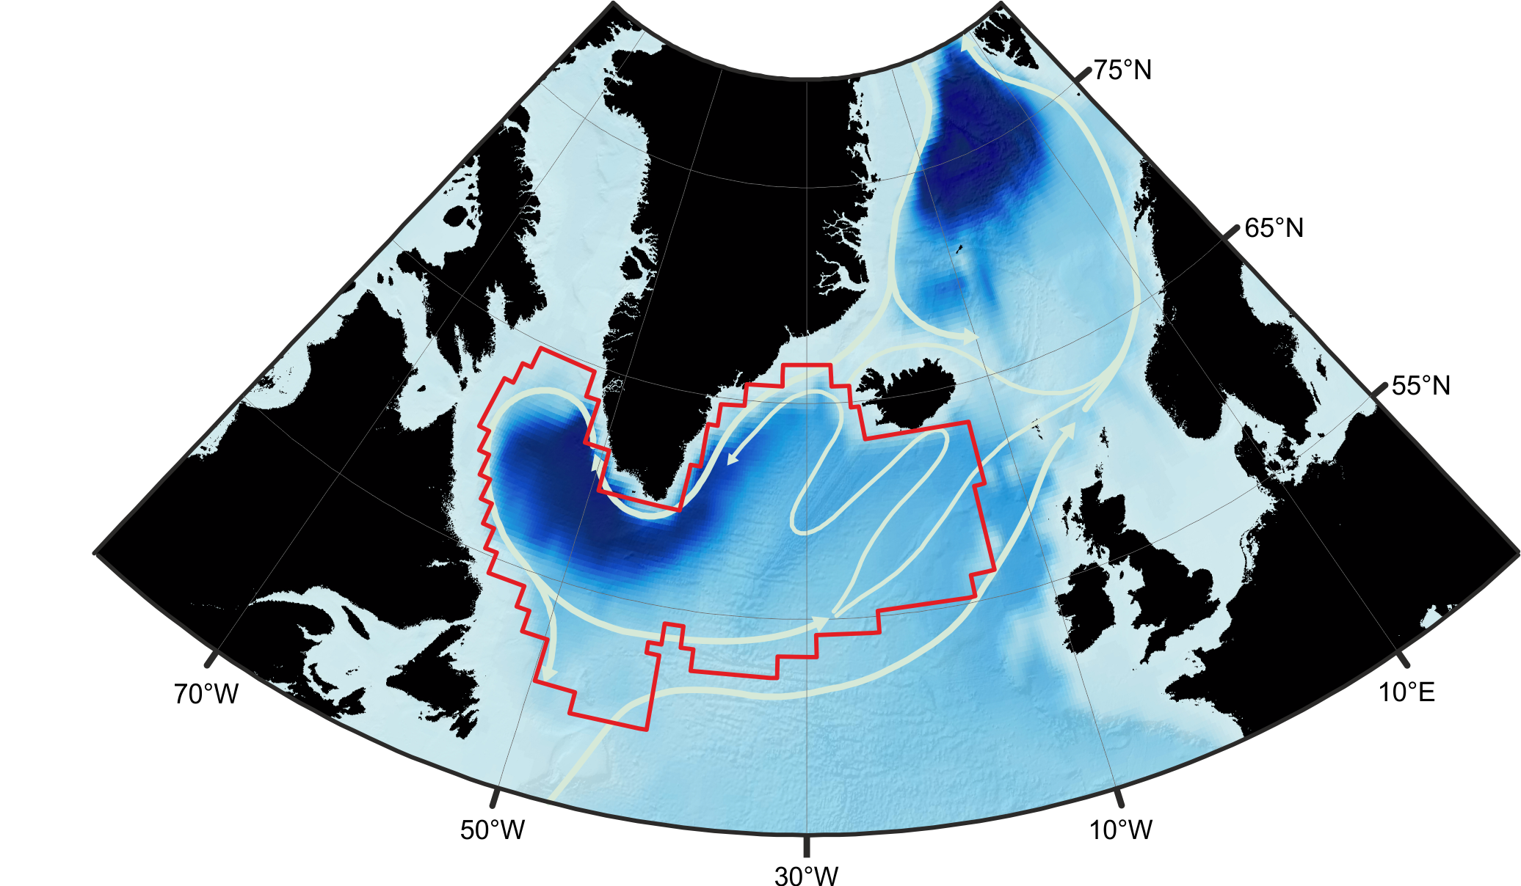
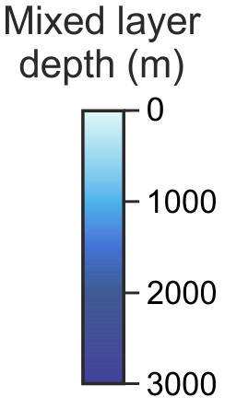
Methods
GLORYS
Reanalysis data
(1993-2013)
Analyse of CMIP5 models with a focus on the subpolar gyre (SPG)
Definition of abrupt change for a given metric: if a 10-year trend > 3 standard deviation computed from annual mean in piControl
Systematic scan of the CMIP5 archive: 40 models (40 piControl simulations, 27 historical + RCP2.6, 39 historical + RCP4.5, 40 historical + RCP8.5 for a total of 146 simulations)

Slide 5
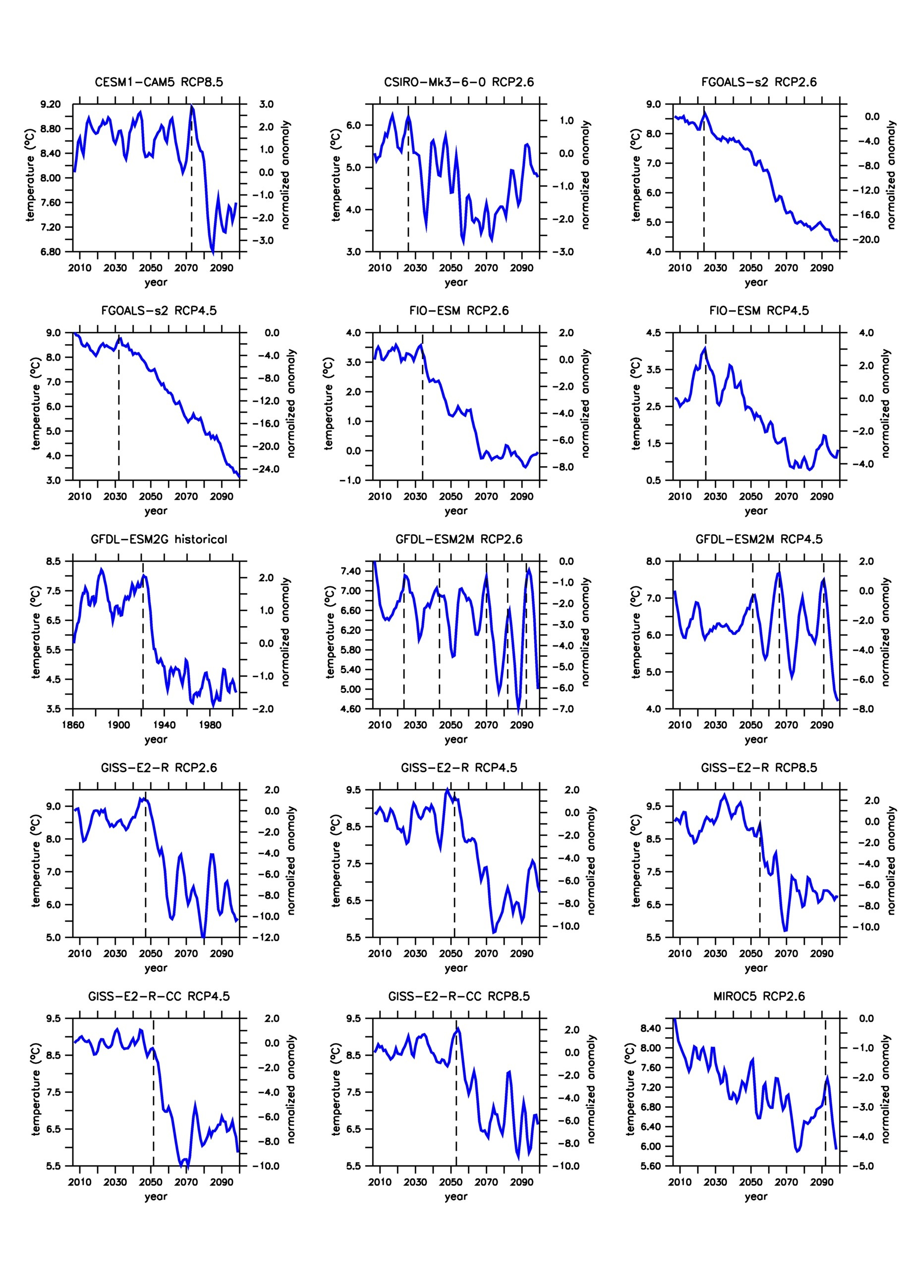
Abrupt cooling events in the SPG
15 abrupt cooling events
1 historical
6 RCP2.6
5 RCP4.5
4 RCP8.5
9 models
(22.5% of the models)

Slide 6
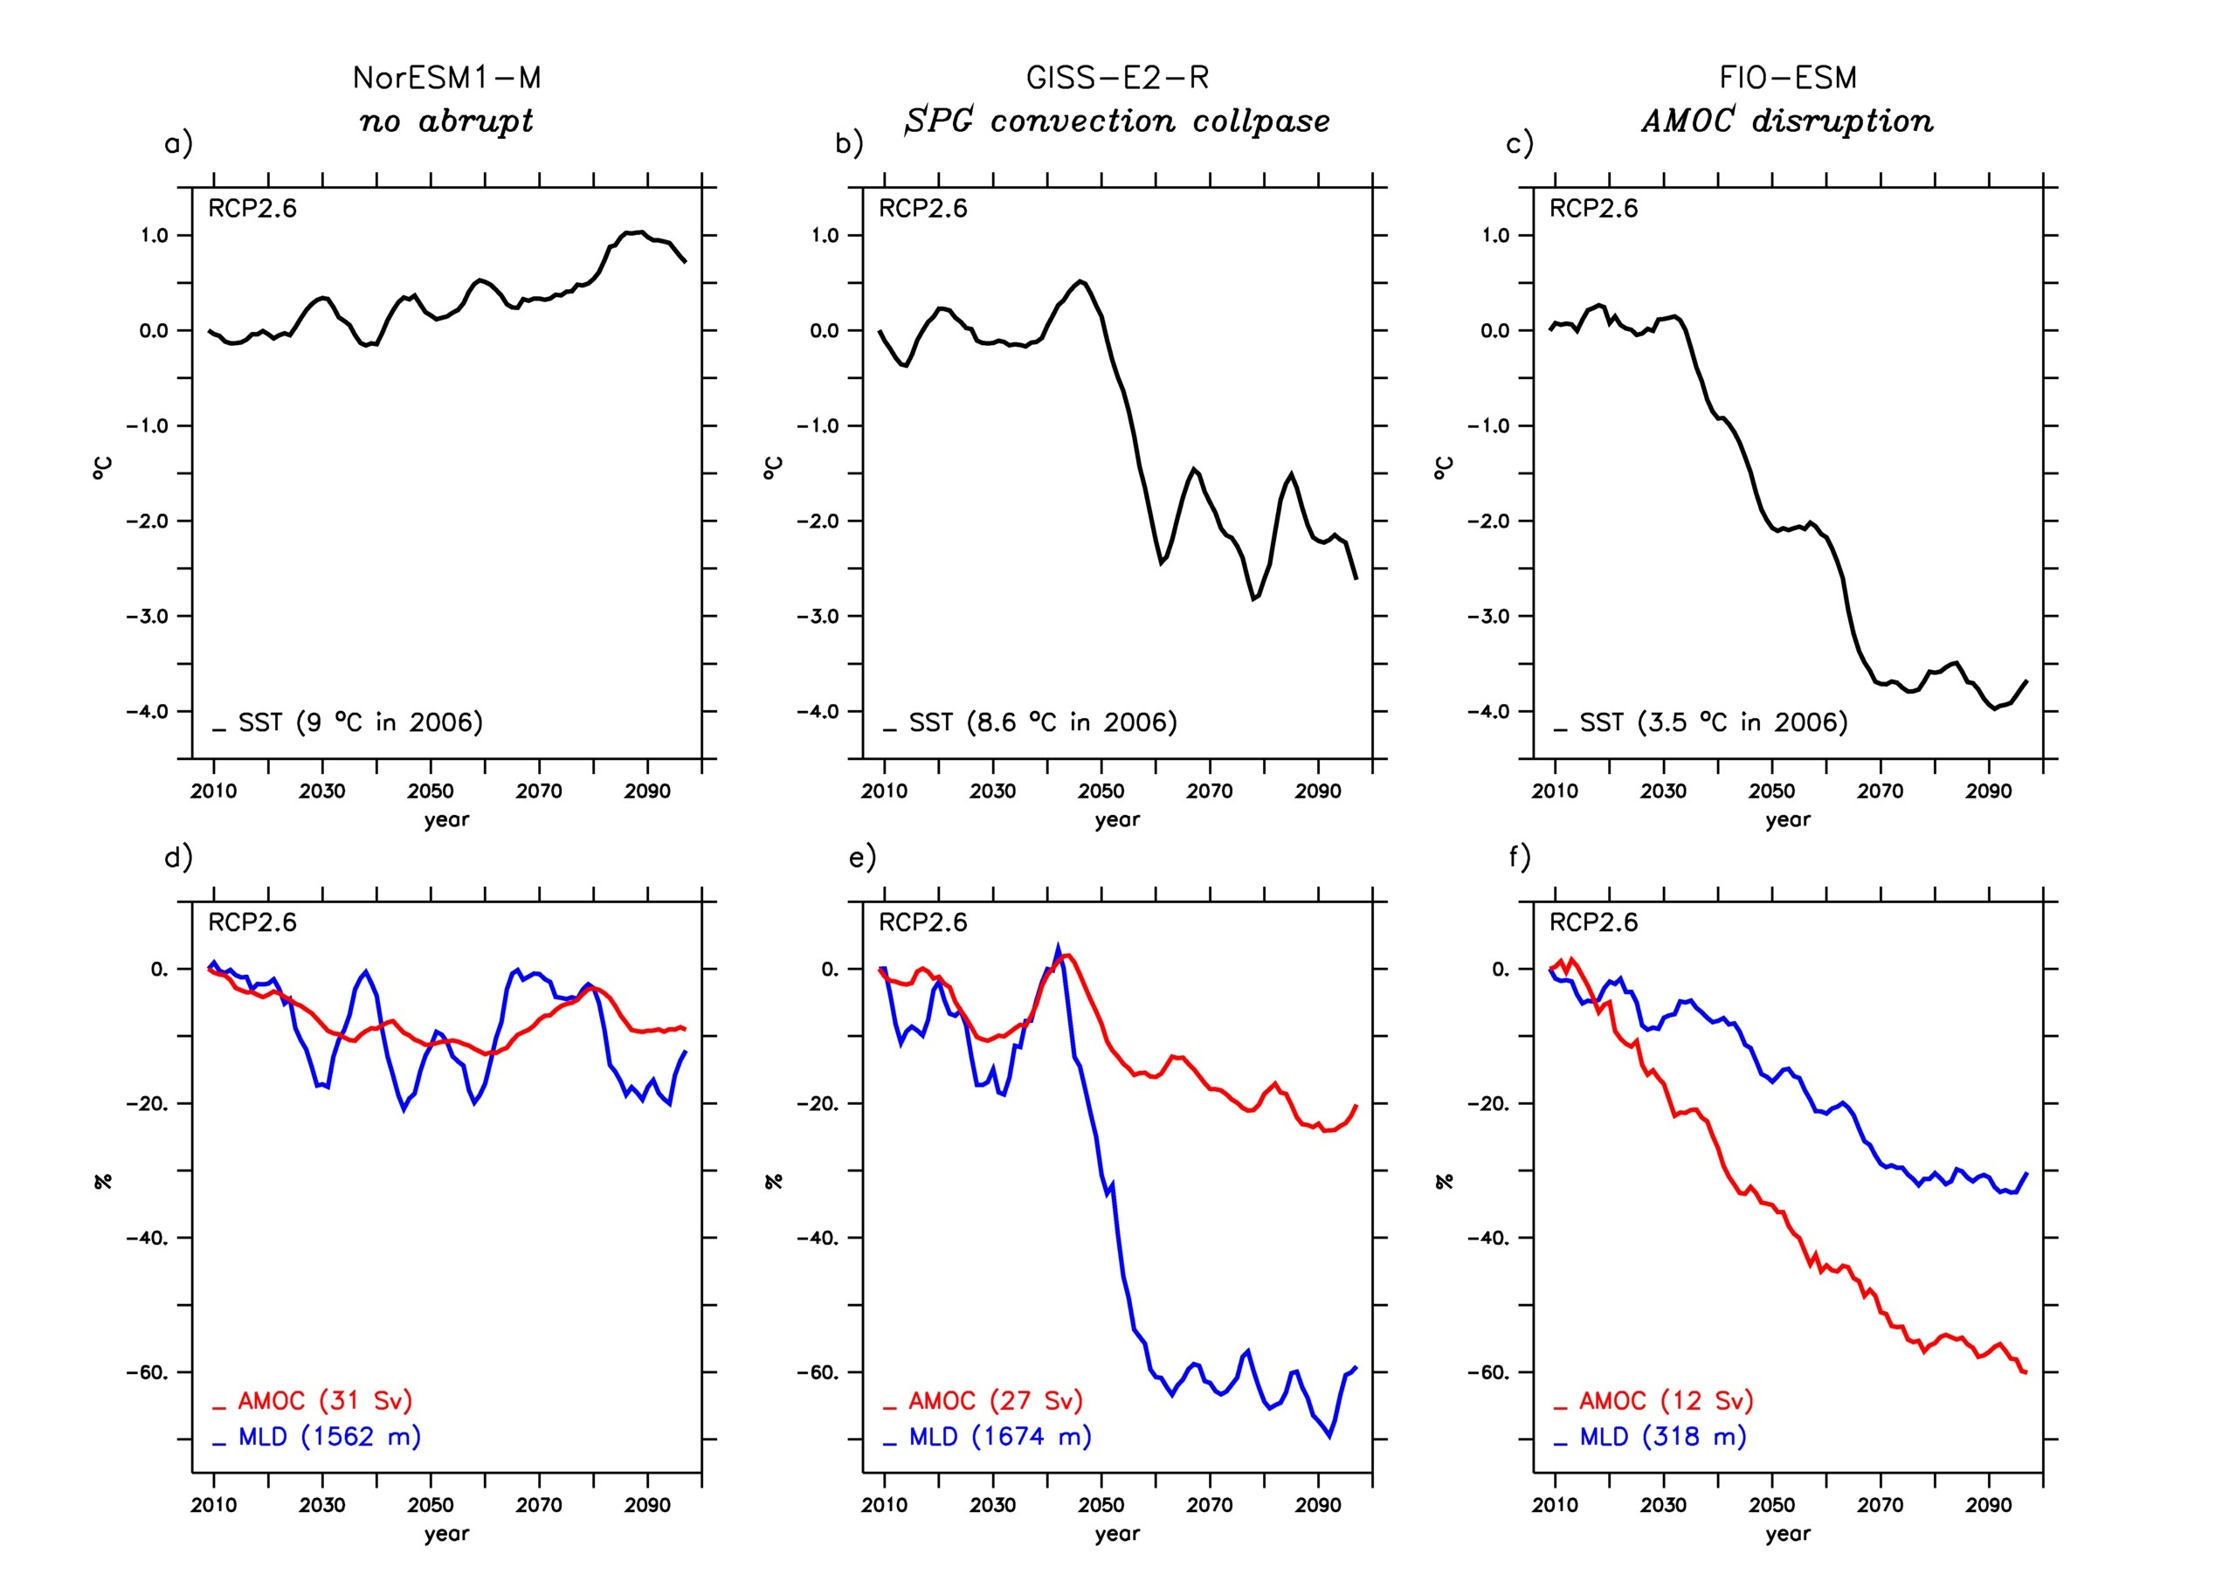
Three main types of SPG changes
non-abrupt
subset
(31 models, i.e. 77.5%)
SPG convection
collapse
subset
(7 models, i.e. 17.5%)
AMOC disruption
subset
(2 models, i.e. 5%)
SST
MLD
AMOC

Slide 7
Mechanisms of the convection collapse
From an analysis of key variables of the different convection collapse models, notably based on cross correlation diagnostics, we end up with the following mechanism to explain the 10-year abrupt cooling in the subpolar gyre, in agreement with proposed mechanisms by Born et al.
The collapse in convection is salinity driven !

Slide 8
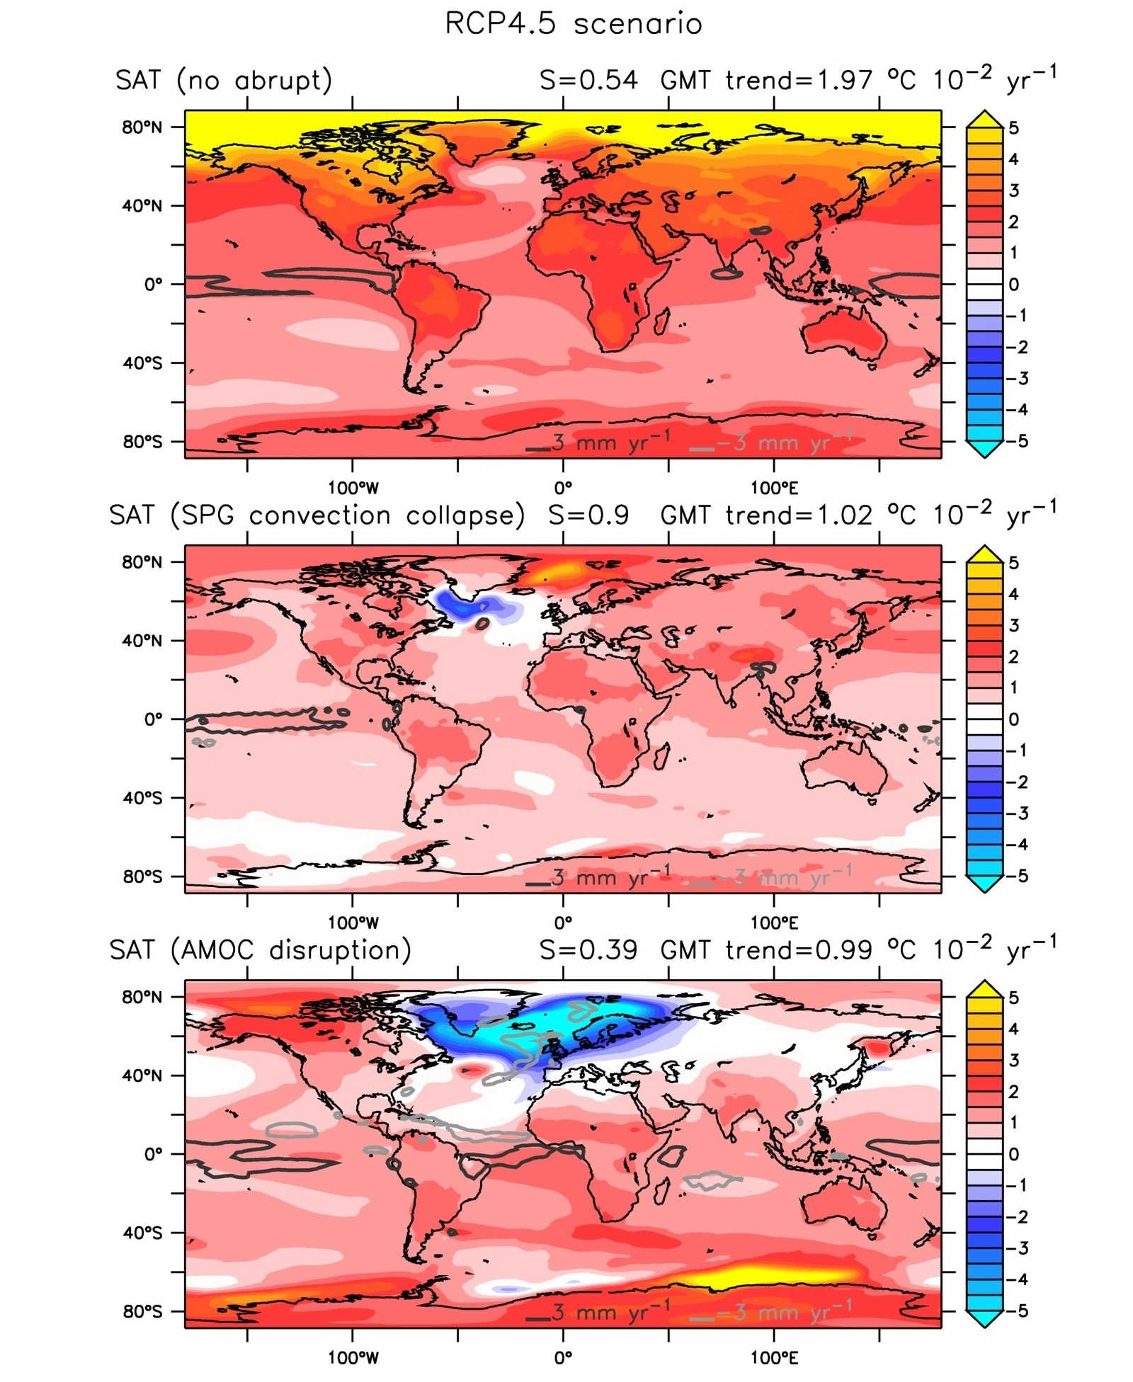
Three different climatic impacts
Surface temperature and precipitation trend (ºC/century) of ensemble mean for RCP4.5 scenario
non-abrupt subset
77.5%
Warming spread all over the globe
SPG convection collapse subset
Cooling trend over the NA SPG despite a global warming trend
Strong impact on SAT over highly inhabited regions
17.5%
AMOC disruption subset
Strong cooling of all the NA
Amplified warming in the southern hemisphere (bipolar see-saw effect)
Shift of the position of the intertropical convergence zone
5.0%

Slide 9
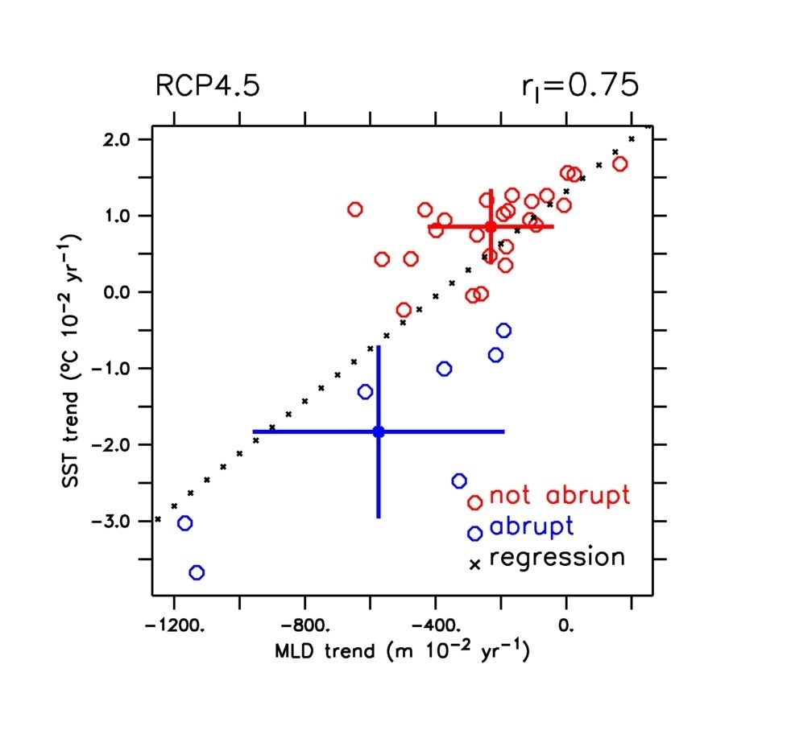
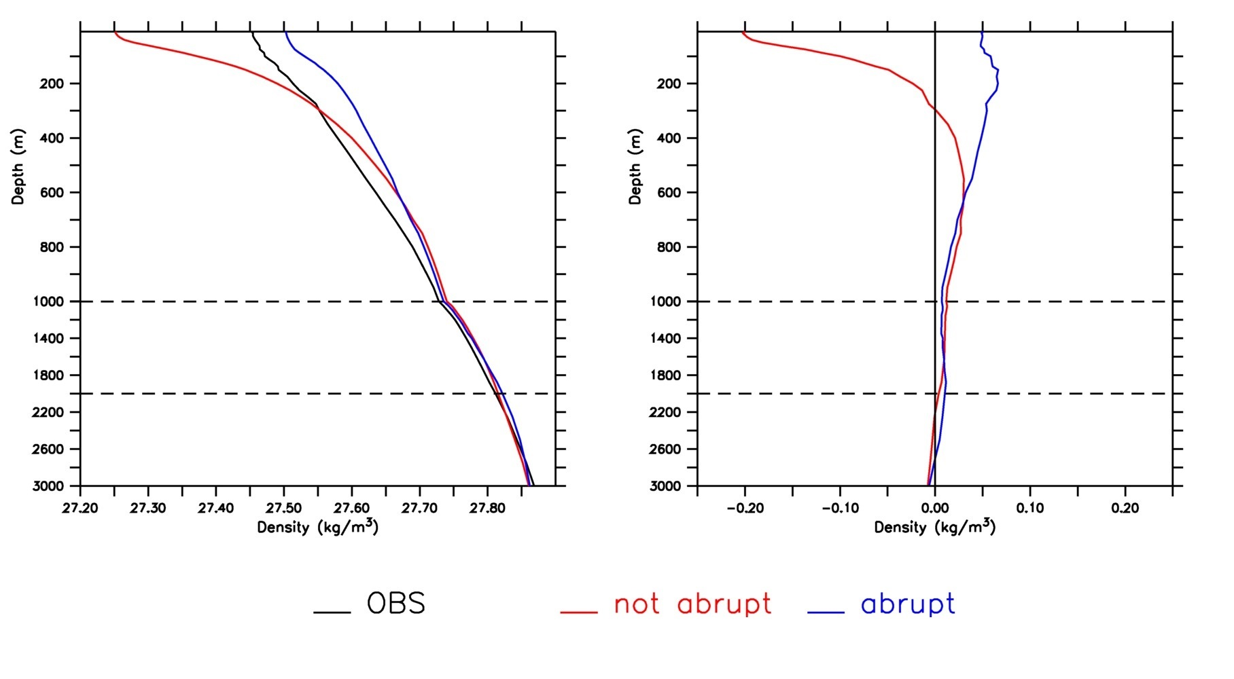
Source of model uncertainty
SST trend vs MLD trend
SST trend over the subpolar NA is well correlated with the MLD trend
Importance of the background stratification
Density profiles
Gap from OBS
Two different configurations for present-day conditions
If compared with OBS:
No abrupt excessively stratified
SPG convection collapse models less stratified
OBS
No abrupt
SPG convection collapse

Slide 10
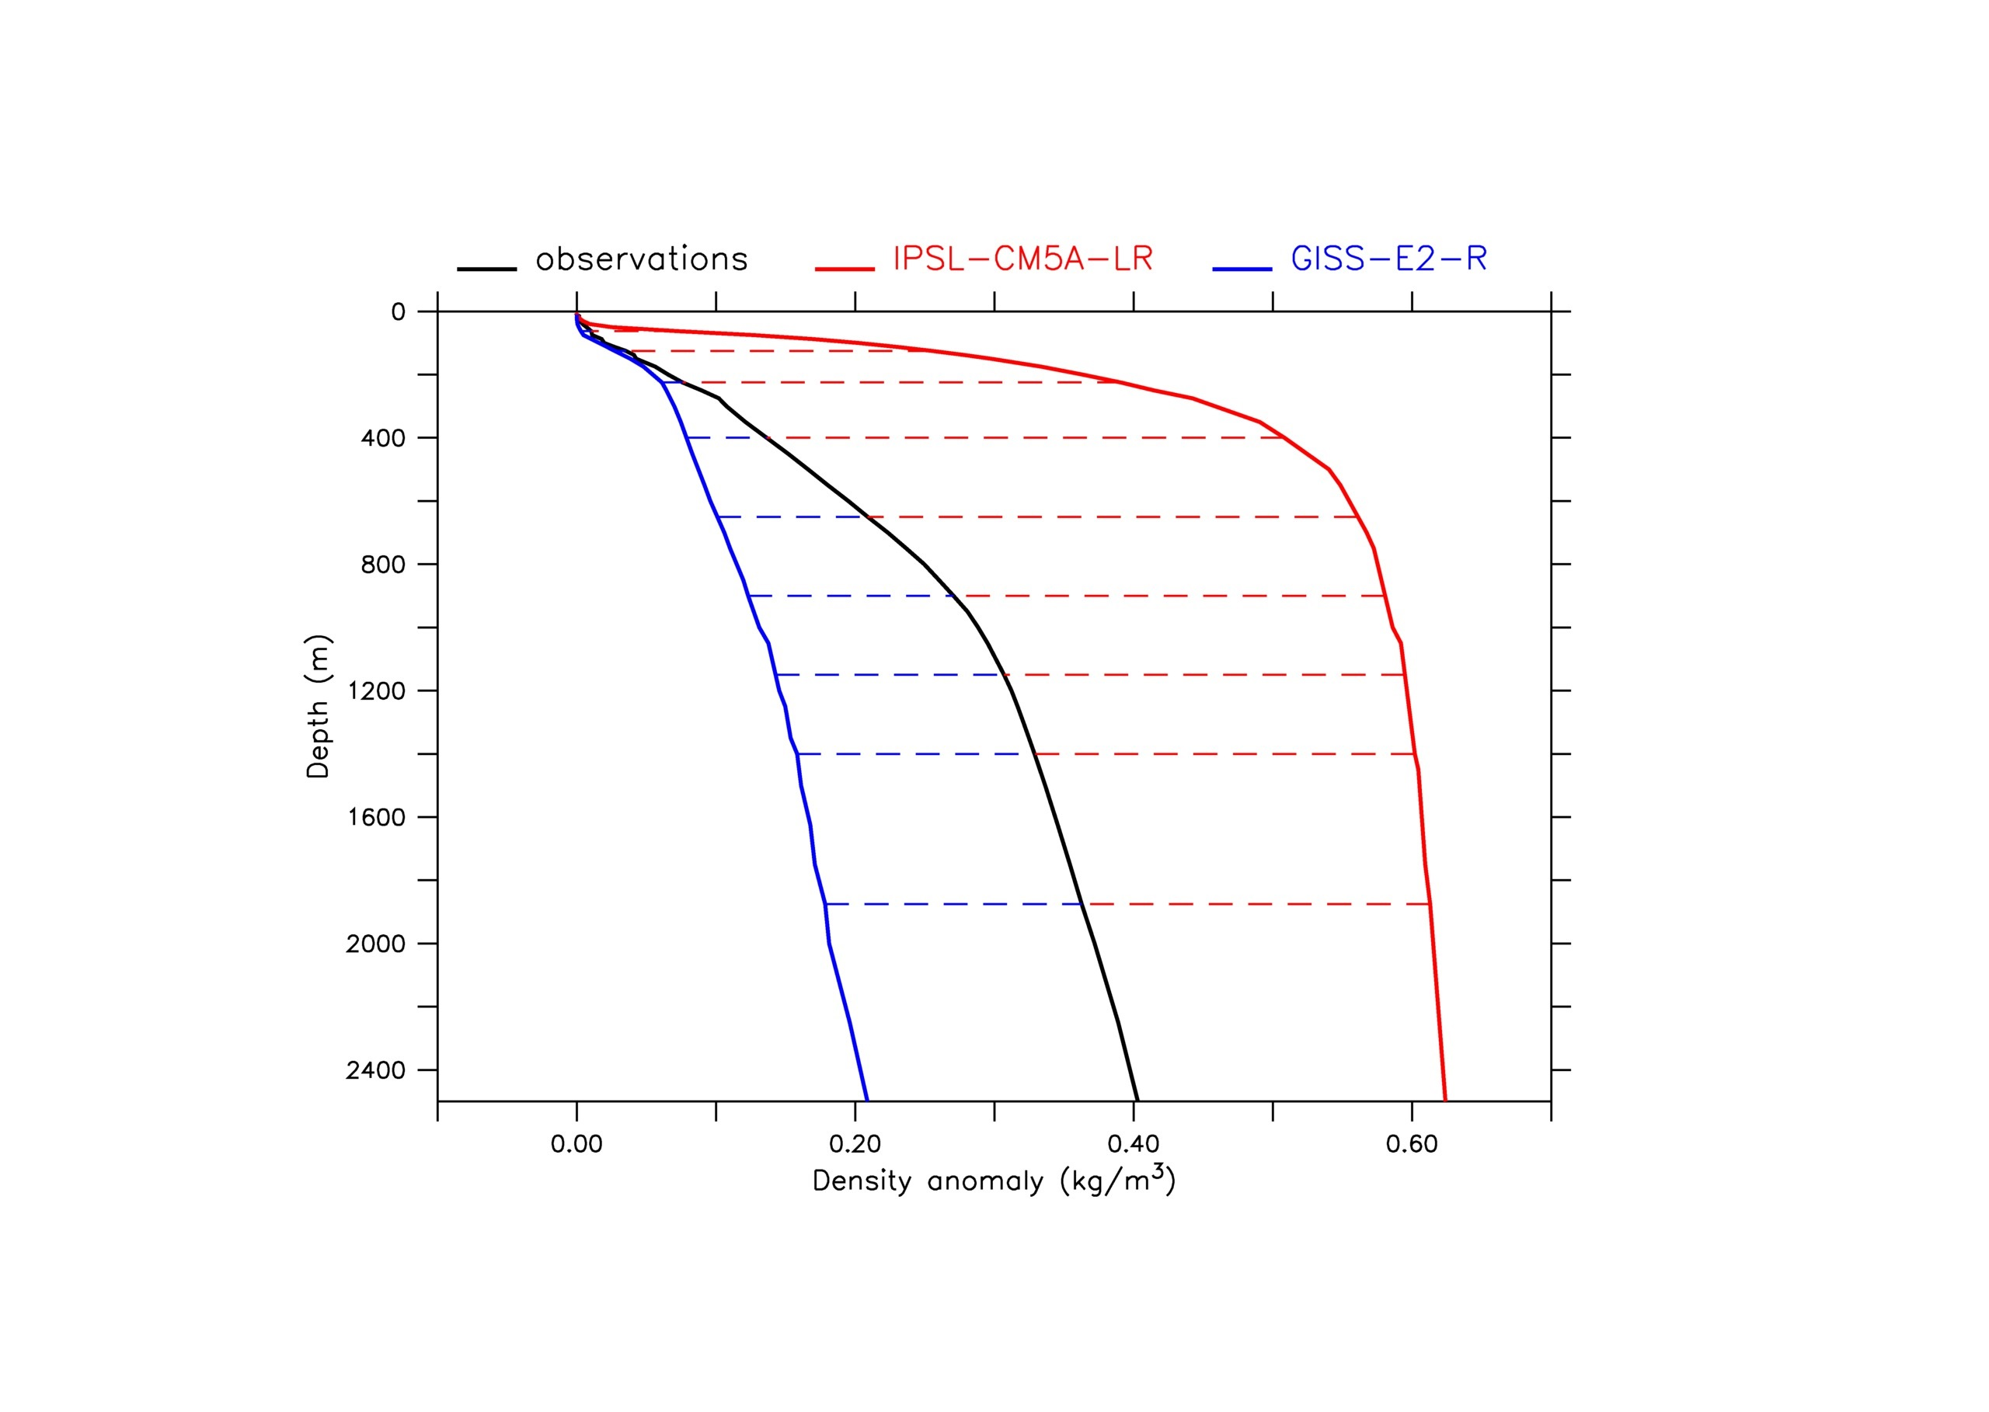
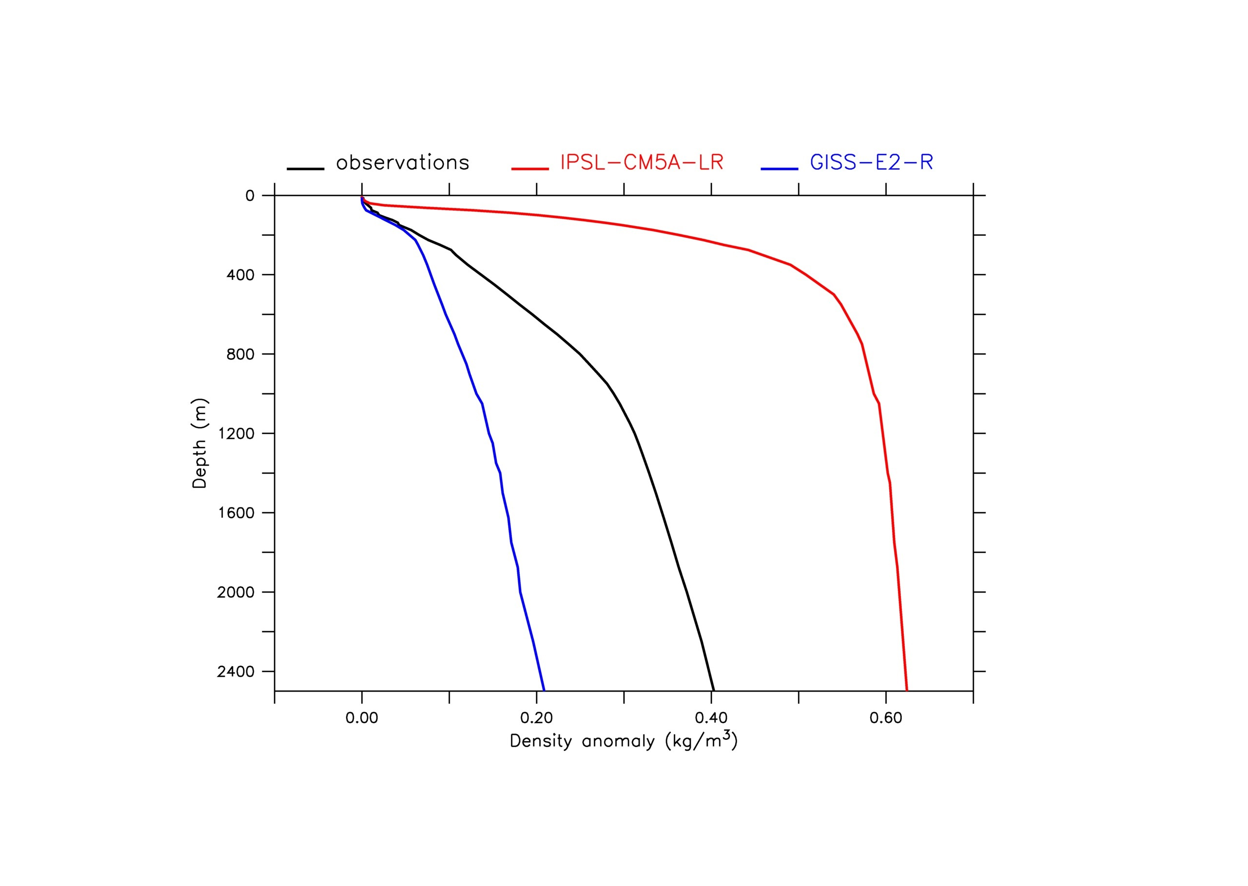
The stratification indicator
We define a stratification index as the density difference with surface density
We estimate the differences in stratification for each model with observation-based estimate of the stratification in the SPG
less
stratified
more
stratified
stratification index
Σ_{z} { (ρ_{z}-ρ₀)_{model} - (ρ_{z}-ρ₀)_{OBS}}
-5.88 (kg/m³)
+12.41 (kg/m³)
Observations: average between GLORYS Reanalysis data (1993-2013) and EN3 Analysis data (1950-2013)
Models: mean during the period 1976-2005 of historical simulations

Slide 11
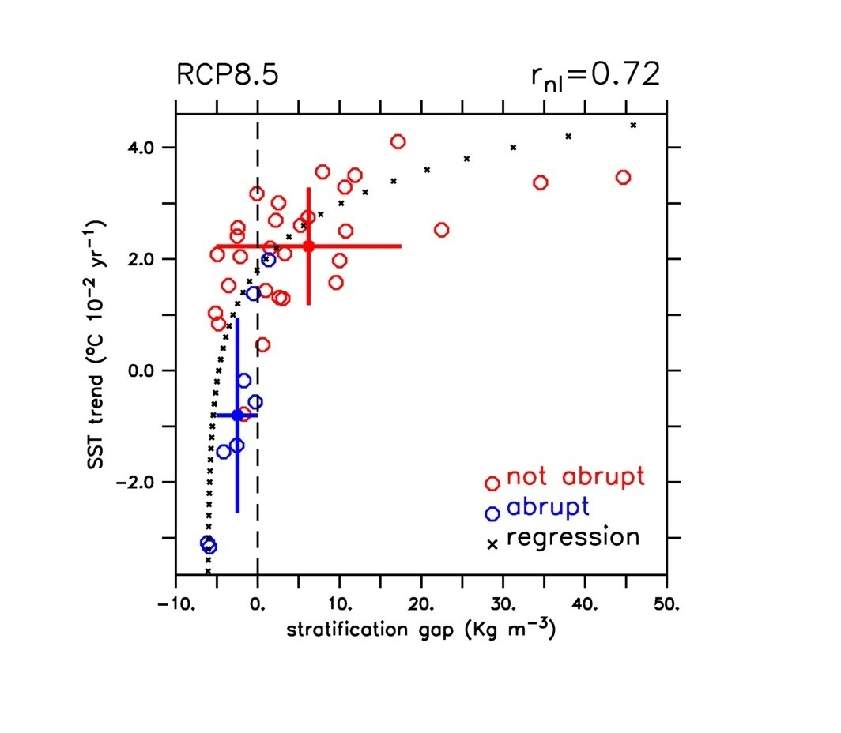
Stratification as an emergent constraint for SST response
SST trend over the SPG is (non linearly) correlated with the modeled present-day stratification
SPG convection collapse models show a stratification closer to observations than in no abrupt models
A realistic background stratification is a necessary (but not sufficient) condition for the local convection collapse
OBS
less stratified
more stratified

Slide 12
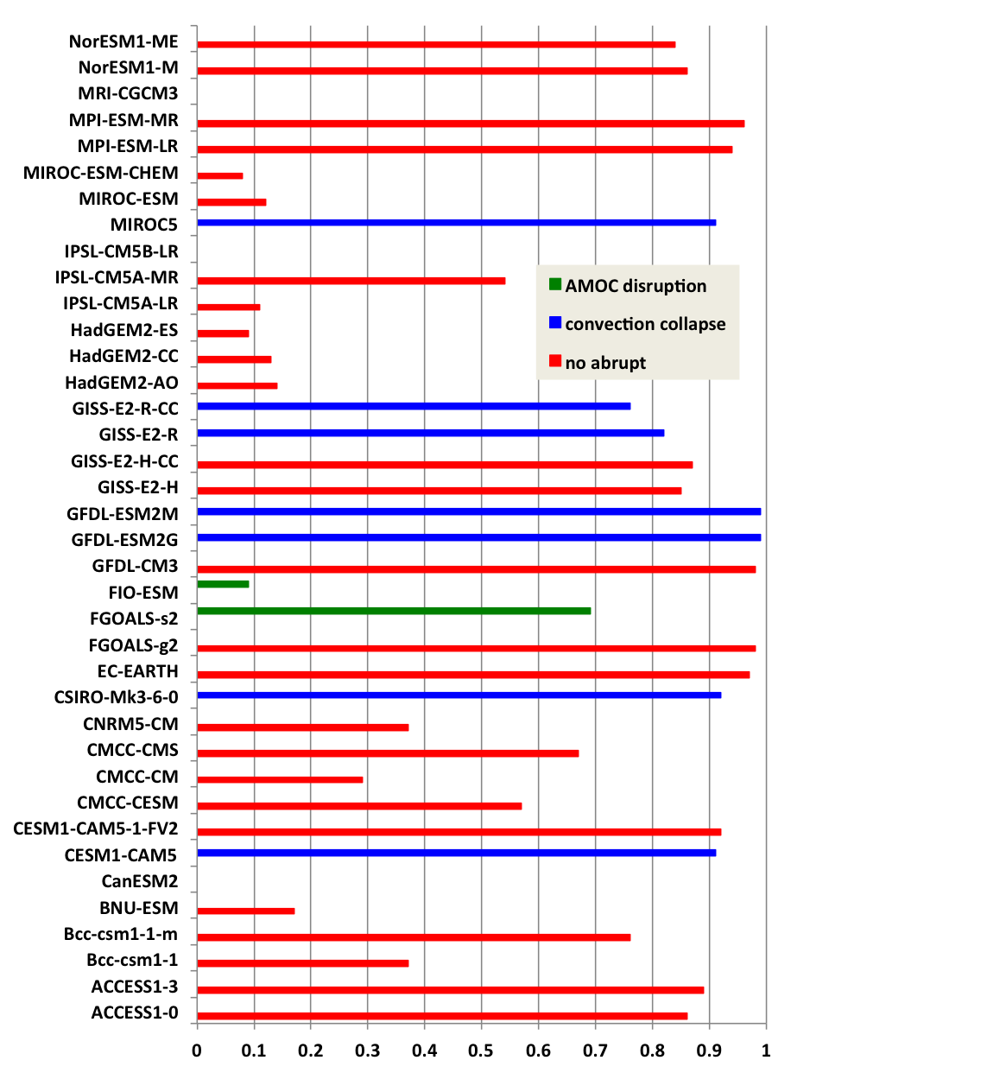
Model evaluation
bad
good
We defined a model skill score S (value between 0 and 1) based on the modeled stratification for present-day conditions
Subset ranking | average S | unweighted occurrence | Occurrence (S>0.9)
1. SPG convection collapse | 0.90 | 17.5% | 45.5%
2. non-abrupt | 0.54 | 77.5% | 54.5%
3. AMOC disruption | 0.39 | 5.0% | 0.0%
When considering only the 11 most skilled models for background stratification, the probability of occurrence of a SPG convection collapse is of 45.5%
Stratification skill score

Slide 13
Conclusions
The SPG convective system should be considered as a tipping element of the climate system (different from AMOC)
A first assessment on the probability of future occurrence of a SPG convection collapse: 17.5%
By accounting only for the 11 most skilled models, the probability of occurrence of a future SPG convection collapse sensibly increases, i.e. 45.5%
An SPG convection collapse may have strong climatic impacts over highly inhabited regions (e.g. western Europe and Eastern North America)
Potentially strong implications in terms of climate change adaptation policies
Need for searching for such potential events in initialised forecasts
No Greenland freshwater release in CMIP5 simulations…

Slide 14

Thank you!
The Blue-Action project has received funding from the European Union’s Horizon 2020 research and innovation programme under grant agreement No 727852

Slide 15
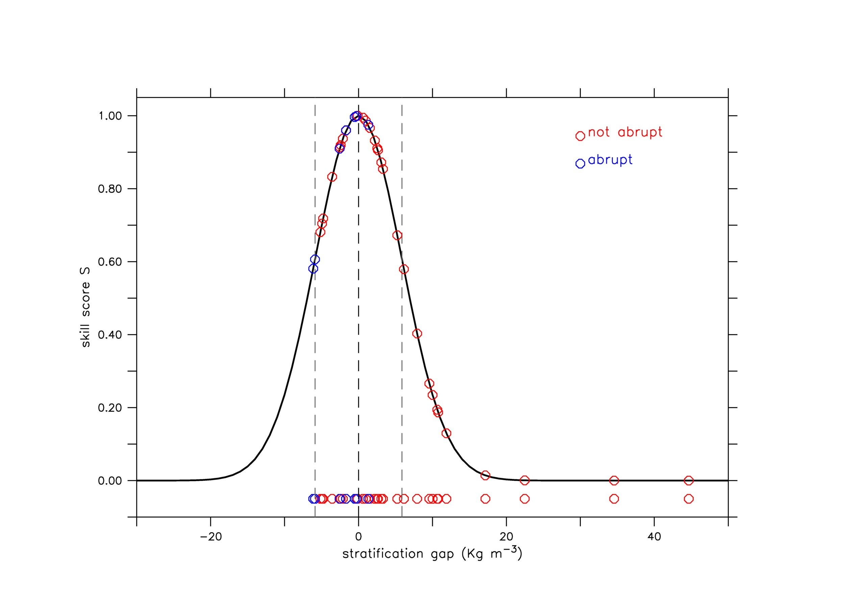
Definition of a model skill score S
−σ
+σ
Hp:
1) The probability that model results matches the reality follows a normal distribution
Skill score S
2) The standard deviation σ is such that 67% of model results lies within the interval [-σ,σ]
Stratification gap
Notes:
By scanning all the CMIP5 repository (piControl, historical, RCP2.6, RCP4.5, RCP8.5)

Slide 16
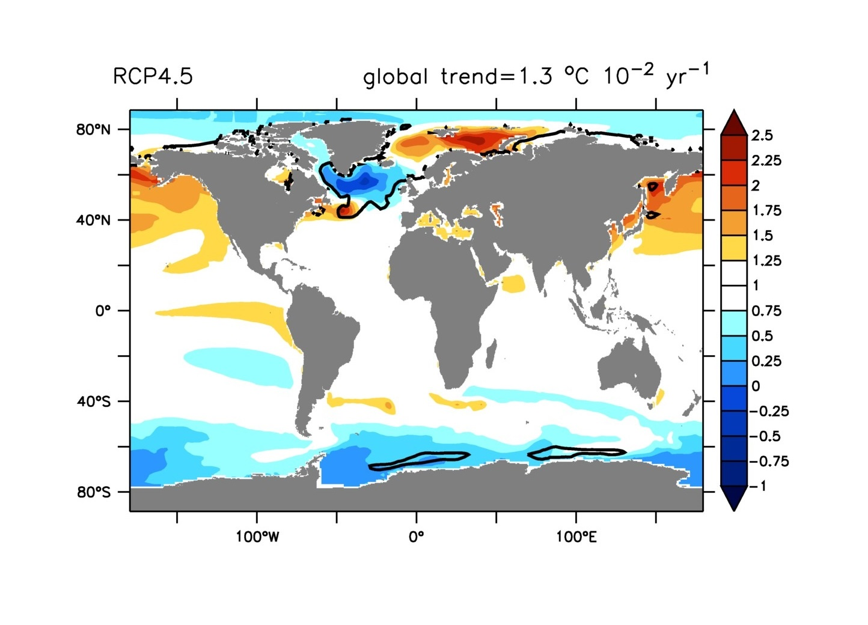
Ensemble mean and spread of SST from CMIP5 model simulations
SST trend normalized by global mean trend
Changes in SST are not uniform:
amplified warming in Nordic Seas
Subdued warming in the subpolar gyre
Notes:
By scanning all the CMIP5 repository (piControl, historical, RCP2.6, RCP4.5, RCP8.5)

Slide 17
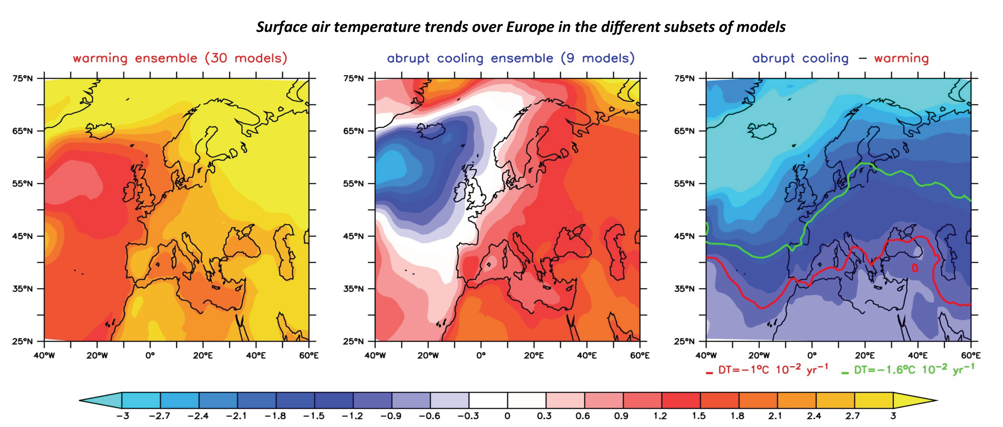
Conclusions and perspectives
Need to consider the possibility of a SPG convection collapse for more specific impact assessments (e.g. agriculture, water management, energy consumption etc.)

Slide 18
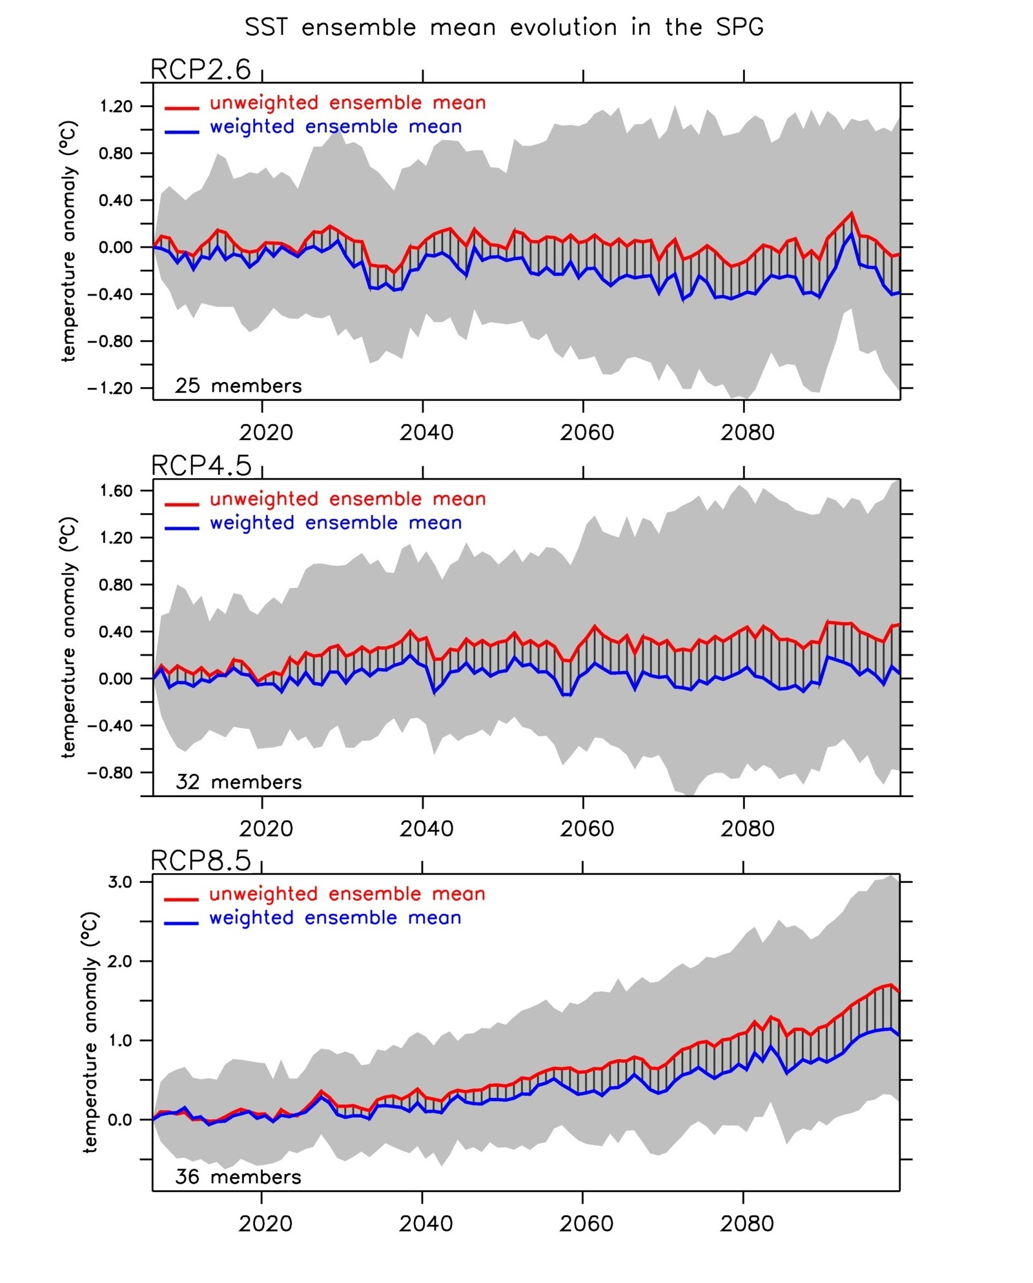
Mechanisms of SST drop due to a SPG convection collapse
Shallower MLD:
heat exchanges with atmosphere confined at surface
Deeper MLD:
heat exchanges with atmosphere involving depths
strong stratification
weak stratification
weak
convection
strong
convection
-
-
Salinity
+
salt inflow
+
stratification
-
-
cyclonic circulation
convection
threshold
MLD collapse
SST drop

Slide 19
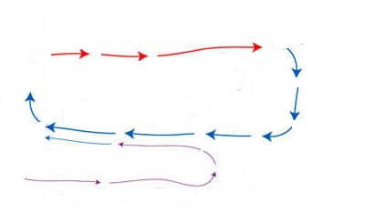
Mechanisms of SST drop due to an AMOC disruption
warmer
salty
colder
NADW
AABW
S
-
N
-
Salinity
+
Northward
salinity transport
stratification
-
-
AMOC
NADW formation
threshold
NADW collapse
AMOC shutdown
SST drop

Slide 20
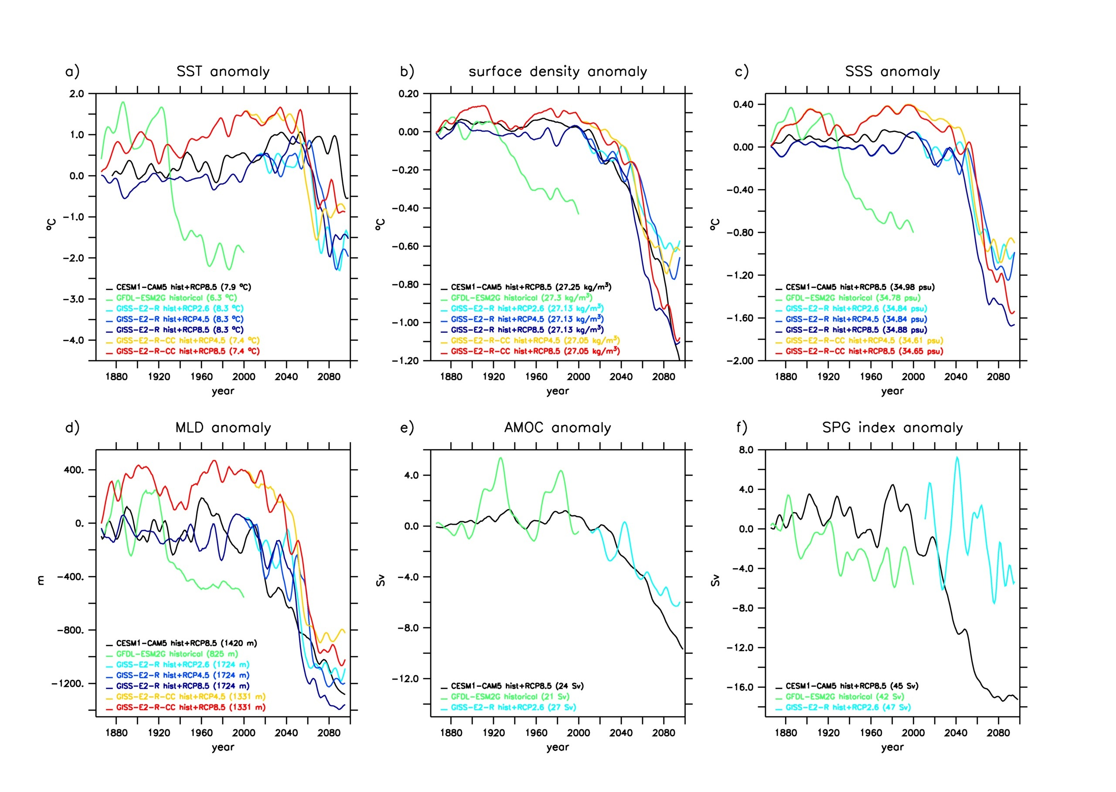

Slide 21
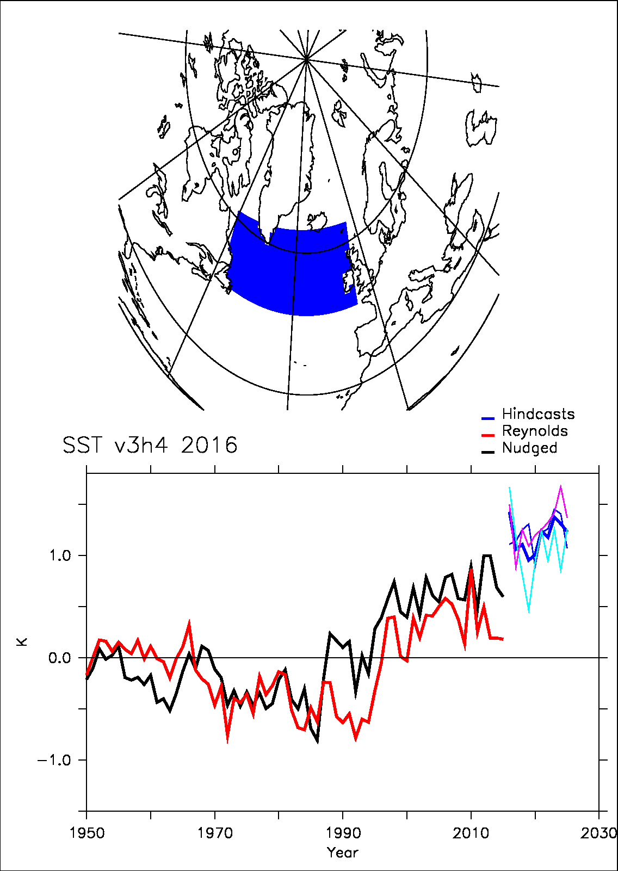
Forecasting the future of the ongoing cold blob
IPSL-CM5A-LR decadal prediction system
Correct predictability of the SST a few years ahead (Mignot et al. 2016)
3-member ensemble of forecasts starting in 31December 2015

