Slide 1

Impact of freshwater release in the Southern Ocean on the Atlantic
Didier Swingedouw

Slide 2
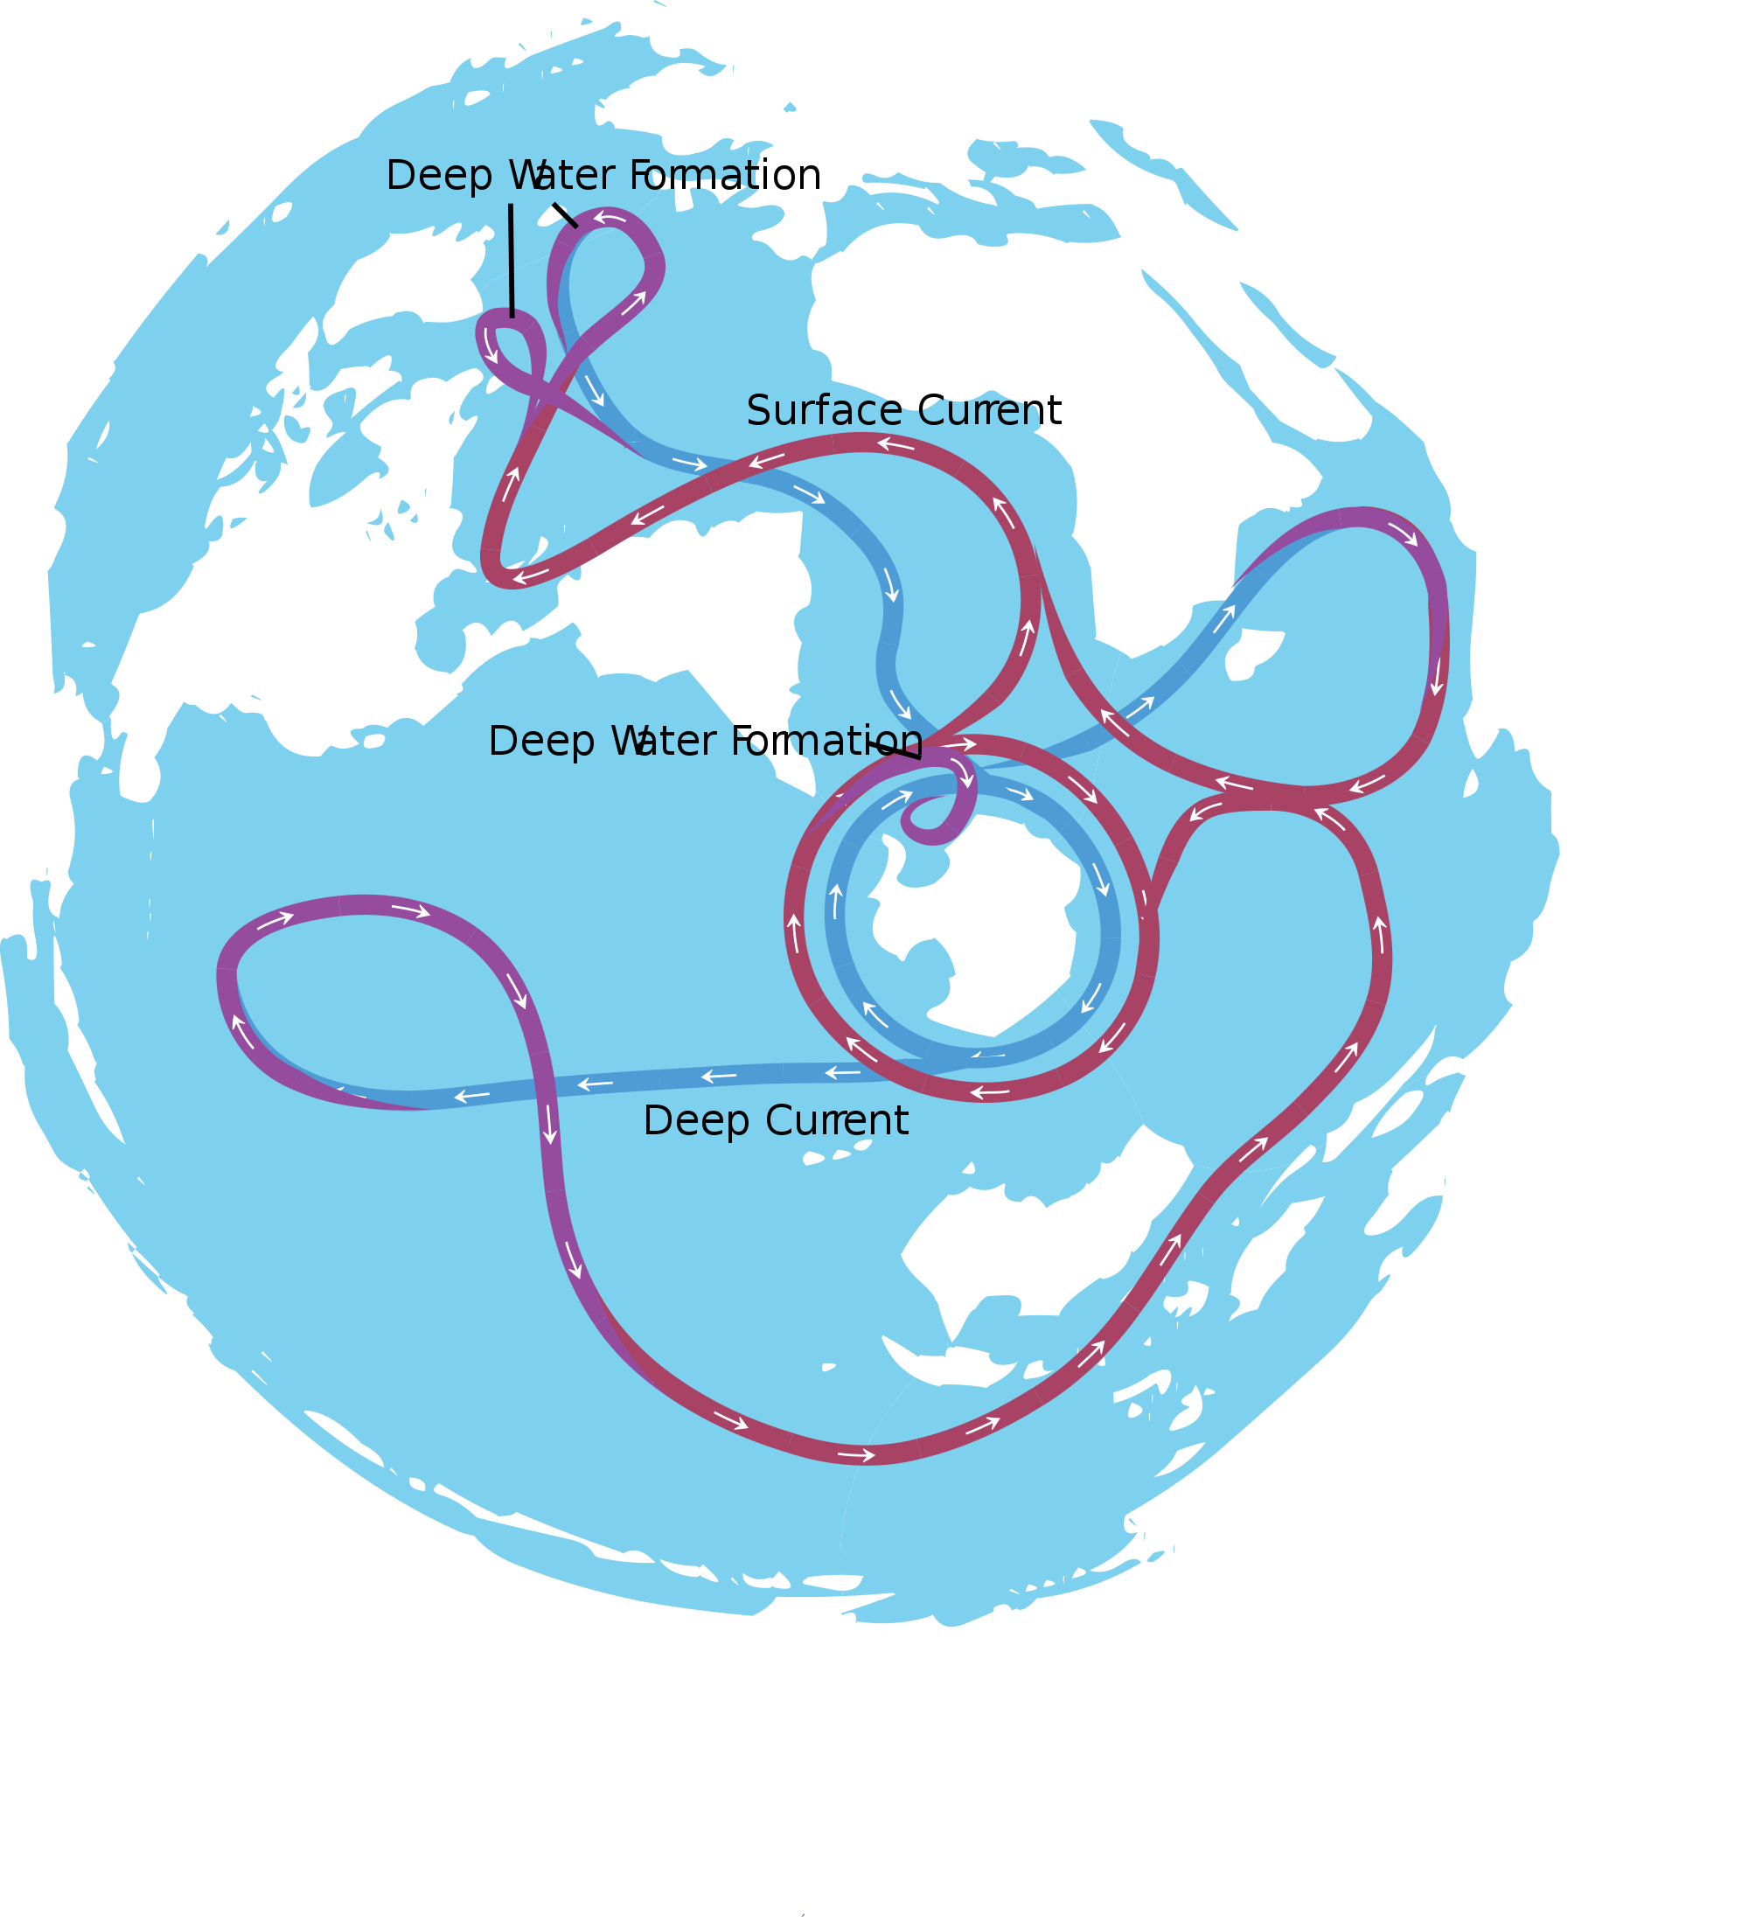

Slide 3
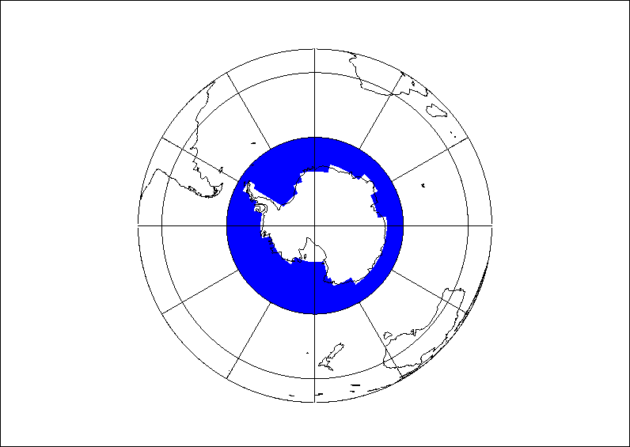
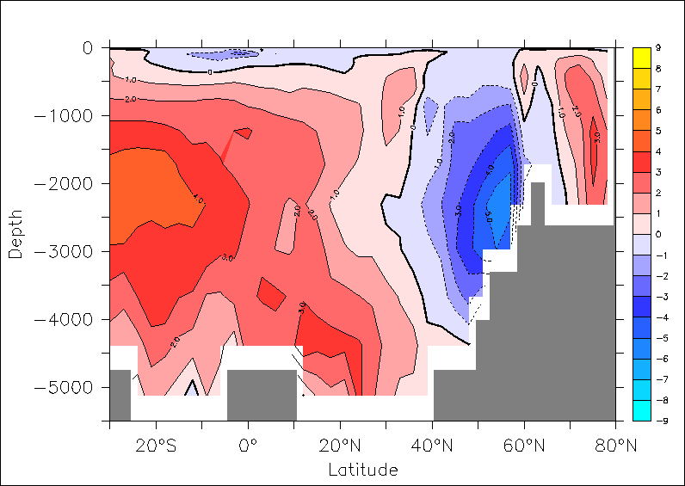
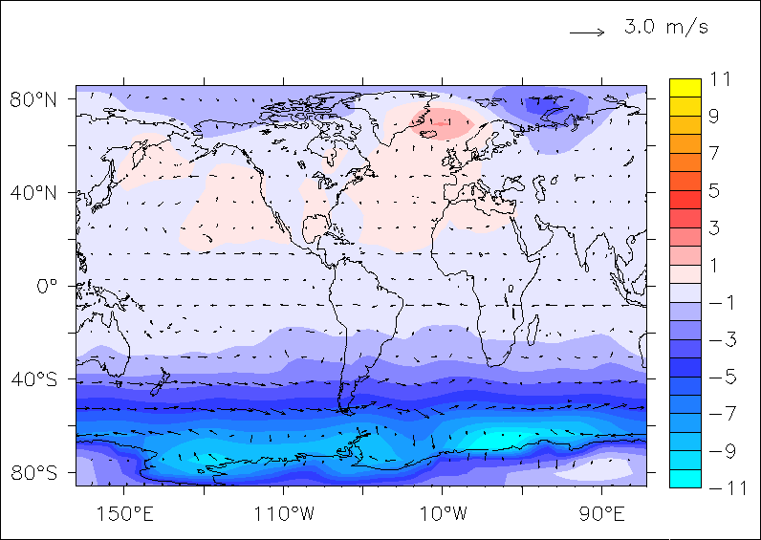
Southern Ocean hosing experiment
AMOC (meridional overturnng streamfunction)
Hos1 - CTRL
Freshwater input in the Southern Ocean (1 Sv over 100 years) using LOVECLIM model
Three potential processes can affect NADW and AMOC
  AABW-NADW seesaw
  Wind stress increase in SO
  SSS anomalies propagation to the North Atlantic
Surface temperature and wind
Hos1 - CTRL
Swingedouw et al. Clim. Dyn. (2009):

Slide 4
Quantification of the impact of each process
Use the density binning analysis, which quantifies the formation-consumption of water masses
Pycnocline
Pycnocline
Pycnocline
to reconcile dynamical and thermodynamical approach (Marshall 1999)
NADW
NADW
NADW
Budget North of 32°S in the Atlantic for water denser than 27.6 kg/m³
AABW
AABW
Depth
Depth
Depth
30°S
30°S
30°S
Latitude
Latitude
Latitude
Notes:
Explique équilibre diffusion consommation

Slide 5

Process 1: bipolar ocean seesaw
Pycnocline
Pycnocline
Pycnocline
Pycnocline
Pycnocline
NADW
NADW
NADW
NADW
NADW
+4,5 Sv
AABW
AABW
AABW
AABW
AABW
Depth
Depth
Depth
Depth
Depth
30°S
30°S
30°S
30°S
30°S
Latitude
Latitude
Latitude
Latitude
Latitude
Notes:
Explique equilibre diffusuion consommation

Slide 6
Process 2: salinity anomalies advection
Pycnocline
Pycnocline
Pycnocline
NADW
NADW
NADW
-3 Sv
AABW
AABW
AABW
Depth
Depth
Depth
30°S
30°S
30°S
Latitude
Latitude
Latitude
Notes:
Explique equilibre diffusuion consommation

Slide 7
Process 3: southern wind increase
Pycnocline
Pycnocline
Pycnocline
NADW
NADW
NADW
+1.5 Sv
AABW
AABW
AABW
Depth
Depth
Depth
30°S
30°S
30°S
Latitude
Latitude
Latitude
Notes:
Explique equilibre diffusuion consommation

Slide 8

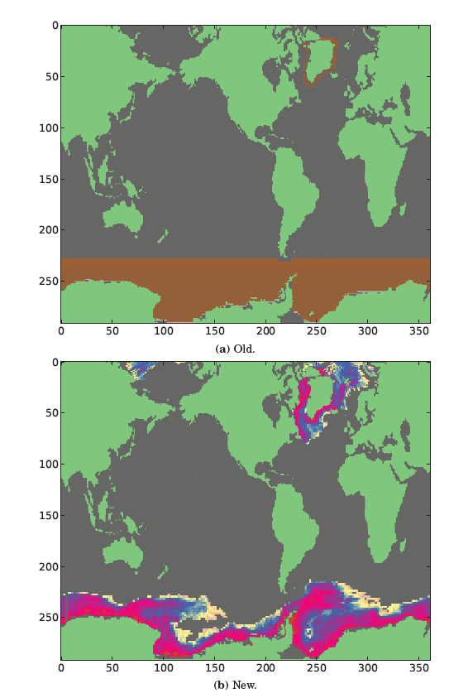
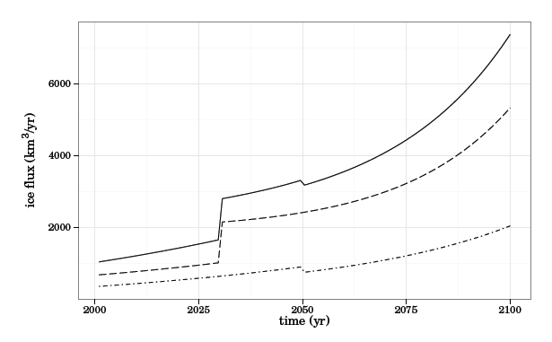
Update from EMBRACE project
New freshwater release scenario including iceberg drifts (van den Berk & Drijfhout et al. 2014)
Melting both in the northern and southern hemispheres based on observation-based hypotheses
4 european models (here focus on only one)
Antarctic
Groenland

Slide 9
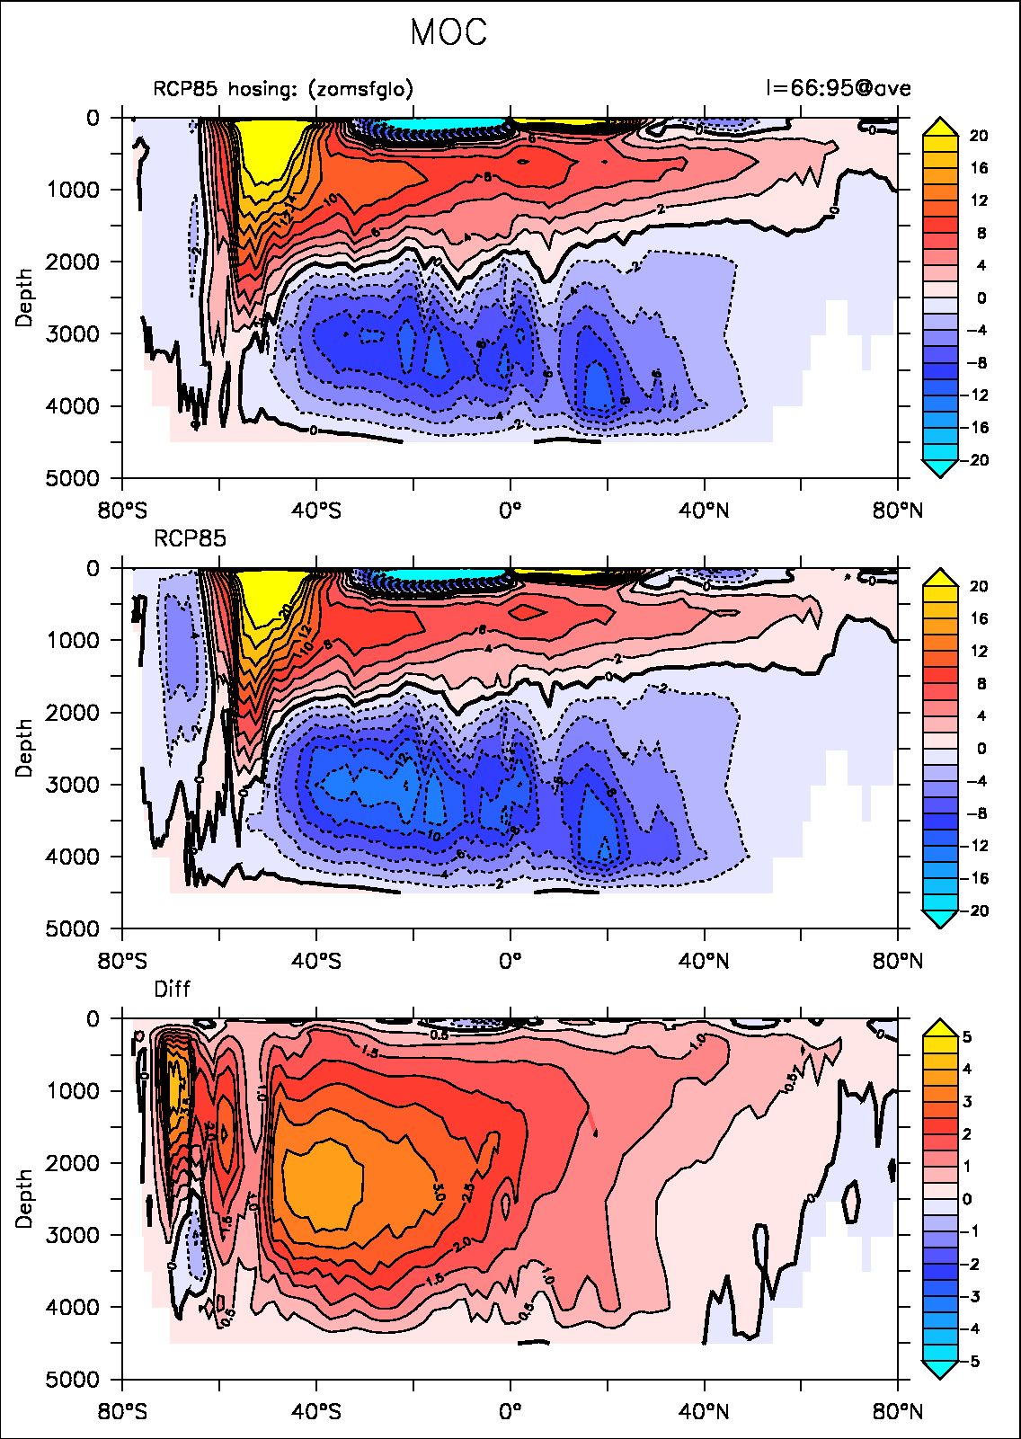

New hosing experiment
Meridional Overtunring circulation
RCP85 with Antarctic ice sheet melting (year 2050-2100)
MOC response in IPSL-CM5A-LR similar to Swingedouw et al. (2009) but here in an AOGCM with more realistic forcing and timing
RCP85 without Antarctic ice sheet melting
AABW
NADW
AABW
NADW
Differences between the two

Slide 10
An impact of Southern variability on the AMOC?
Observations 1974-1976
Climate model

Slide 11

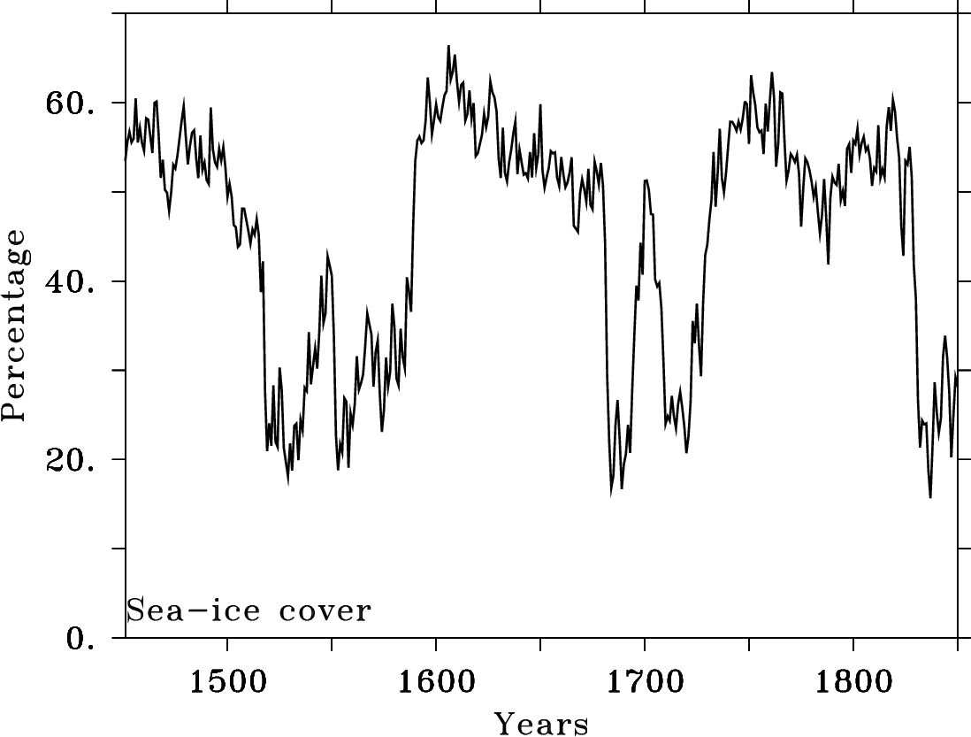
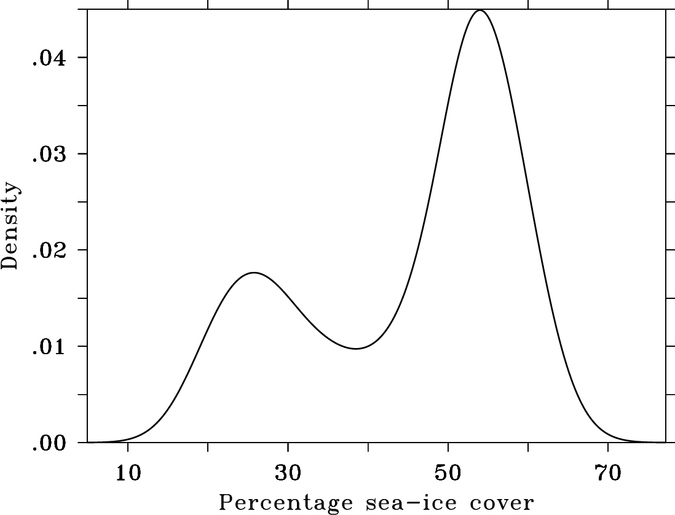
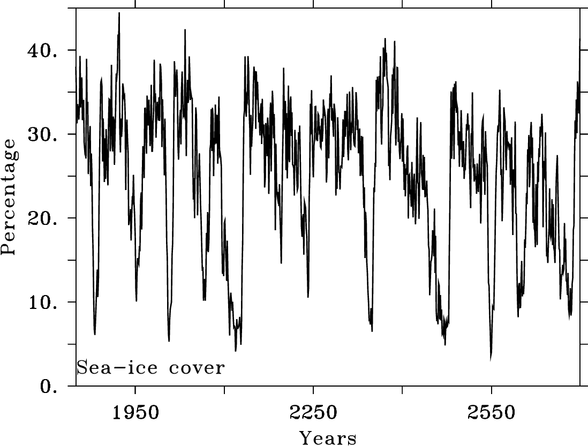
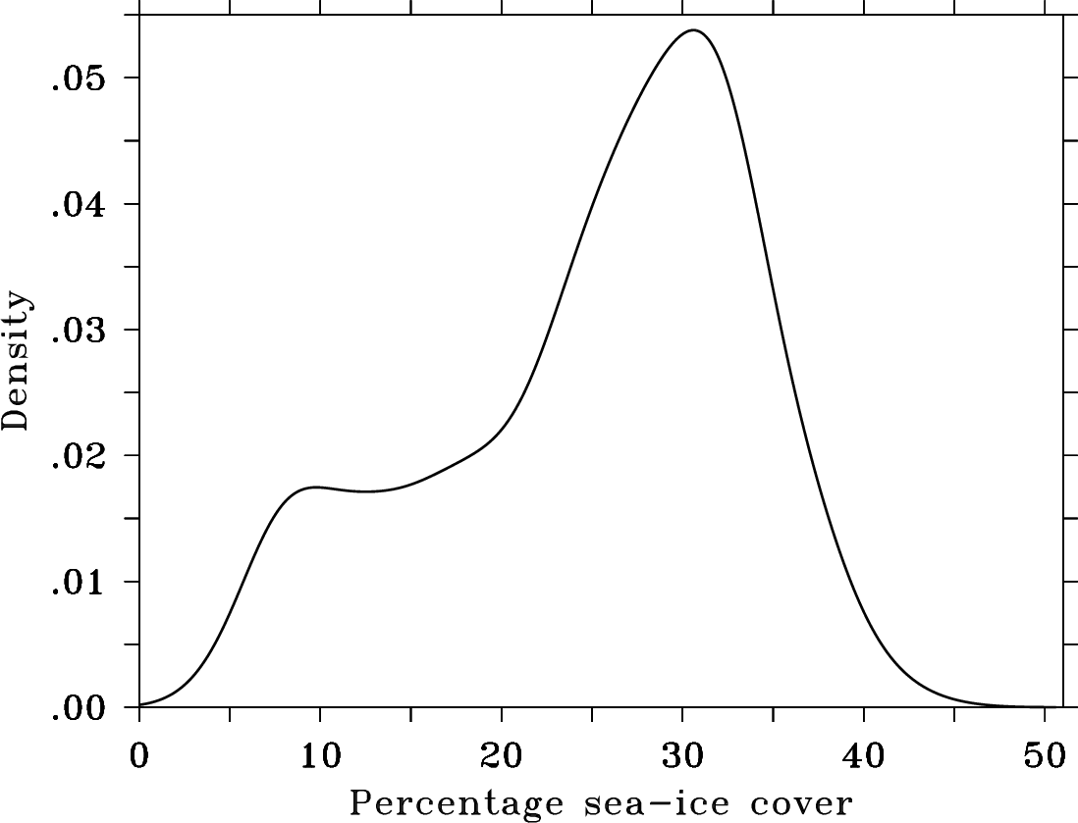
Bistability in CMIP5 climate models?
bcc-csm1-1-m
Drijfhout et al. (in rev. in Nature): abrupt events in the Southern Ocean within CMIP5 database
bistability charateristics (dip test)
CNRM-CM5

Slide 12
What do models tell us about polynya variability?
Bimodal distribution of CMIP5 models – most either convect 0% or 100% of the time.
Stratification influenced by eddies, atmospheric fluxes, mixing and overflow parameterisations…
Are repeated, cyclic Weddell Polynyas real or a model artefact?
Slide from Adele Morisson, with data from de Lavergne et al. 2014

Slide 13
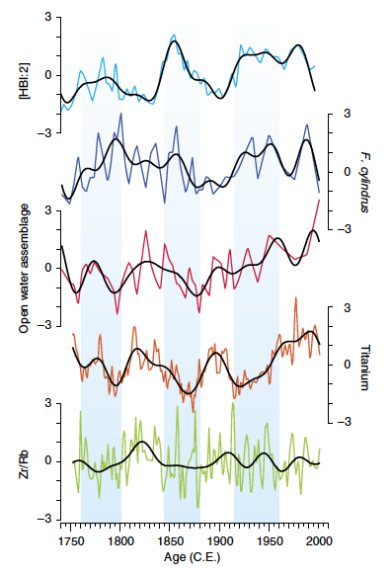
Variability induced by the Southern Ocean?
Possible 60-80-yr variability in AABW production near Mertz (Campagne et al. 2015) due to ice shelf dynamics
An impact on NADW (60-80 years periodicity for the AMO…)?

Slide 14
Conclusions
AABW production can play a role on NADW extension and formation very rapidly (wave adjustment)
Bipolar ocean seesaw imply complex response of the ocean to ice sheet melting, with possible compensation
Natural variability in AABW formation can play a large role on the AMOC

Slide 15
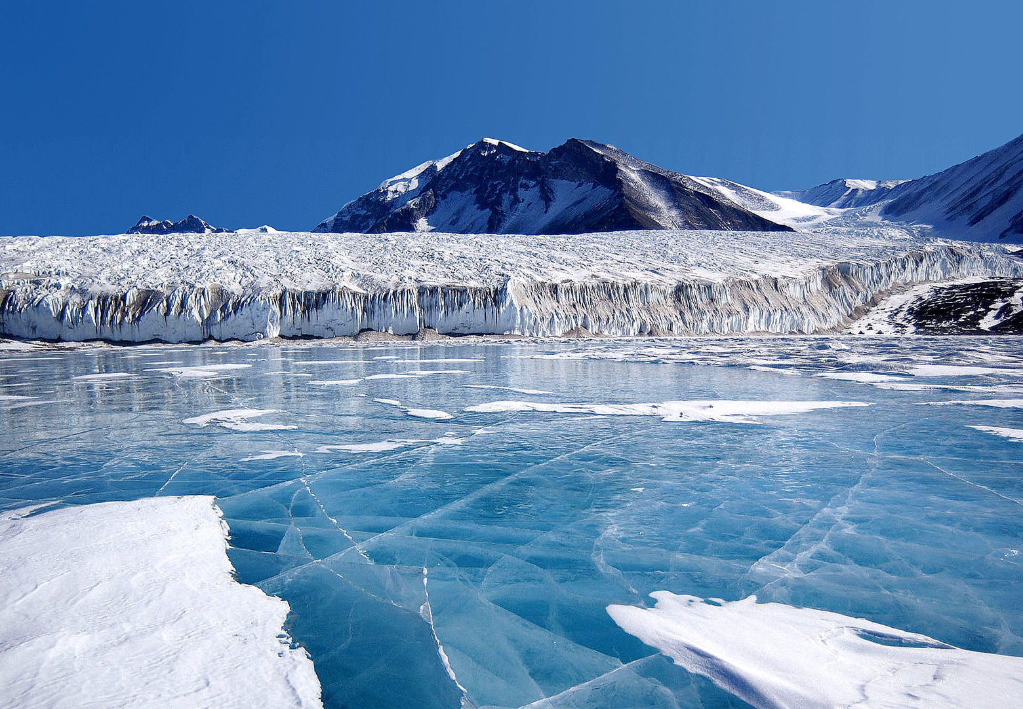
Thank you
Mailto: didier.swingedouw@u-bordeaux1..fr
Web: http://dods.ipsl.jussieu.fr/dssce/public_html/index.html

